Slide 2
GOAL
Evaluate if exciting more than 1 dendrite will impact the FS curve and allow for higher firing rates. Further, validate that the chosen dendrite is not deterministic in any of the experiments performed by exciting a separate dendrite and determining substantial equivalence.

Slide 3
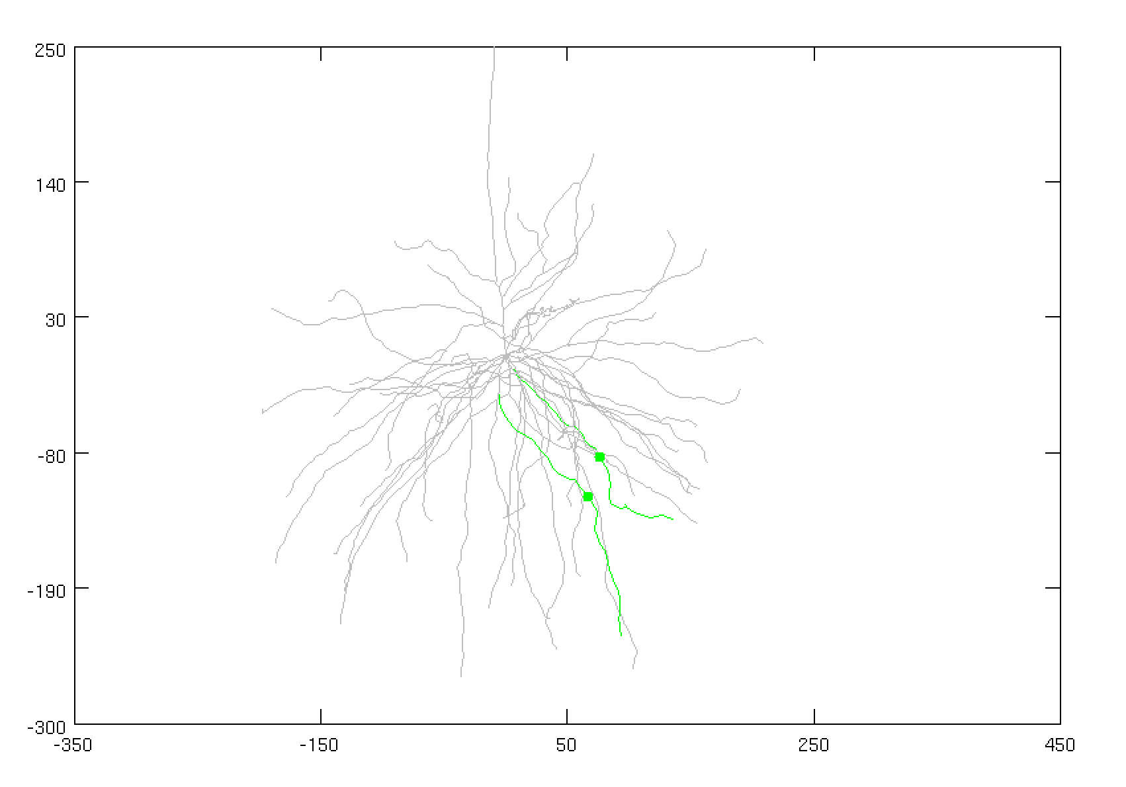
Parameters
Inhibitory Gamma
# of Syns: 30 (ON SOMA)
Firing rate: 50 Hz
Distribution: 3 ms
Conductance: 0.01 µS
Adjusted Current
Amplitude: 2.52 nA
Noise: 0 nA
Stimulus
Dendrite: VARIABLE
Total synapses: 40 synapses
AMPA: 0.0015 µS
NMDA: 0.0039 µS
Firing rate: 50 Hz
Start Time: 5 ms
Noise: 0 ms
Location: 50% of the dendrite (focal, synchronized)
AVG: 25 trials
CONSTANT
VARIABLE

Slide 4
Dendrite Similarities
h.a1_111 (Control)
Length: 243.89 µm
Distance to Soma: 138.67 µm
h.a2_12122
Length: 243.97 µm
Distance to Soma: 159.41 µm

Slide 5
Case 1: Control (Standard Synapse)
STIMULUS
Dendrite: h.a1_111

Slide 6
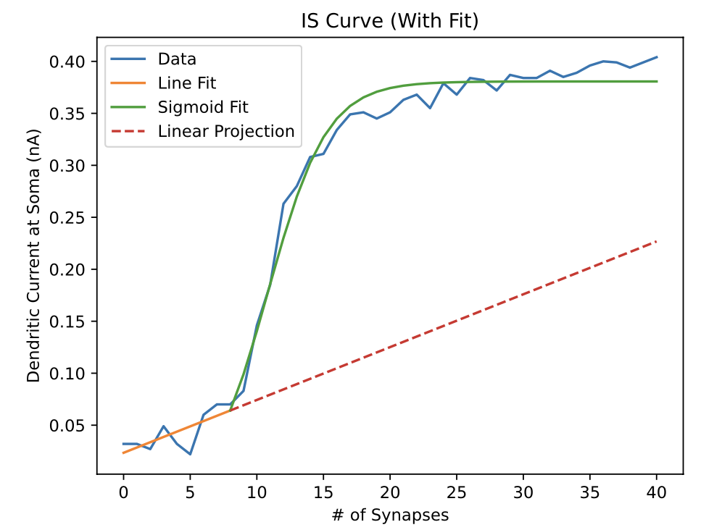
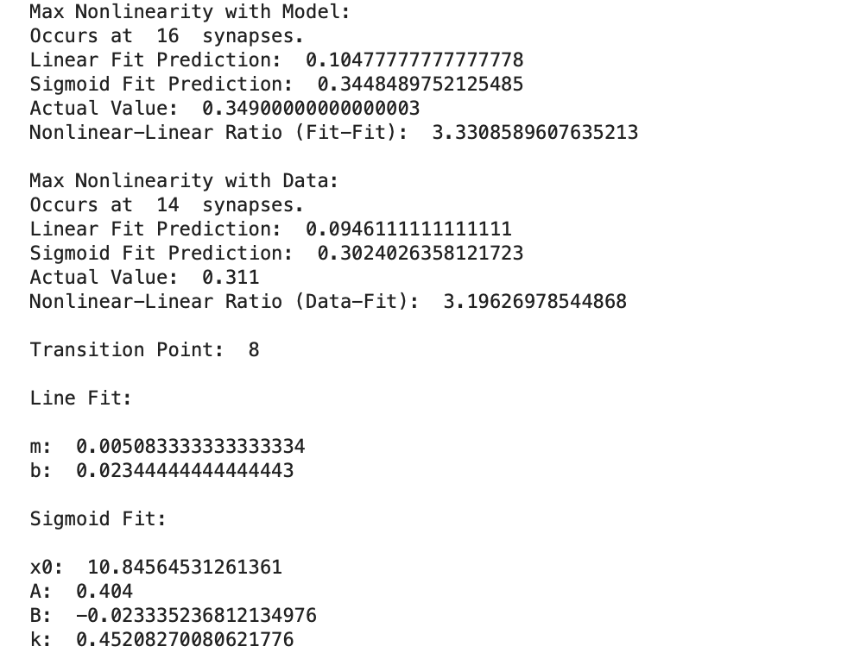
Case 1: Control (Standard Synapse)
STIMULUS
Dendrite: h.a1_111

Slide 7
Case 2: SECOND SYNAPSE
STIMULUS
Dendrite: h.a2_12122

Slide 8
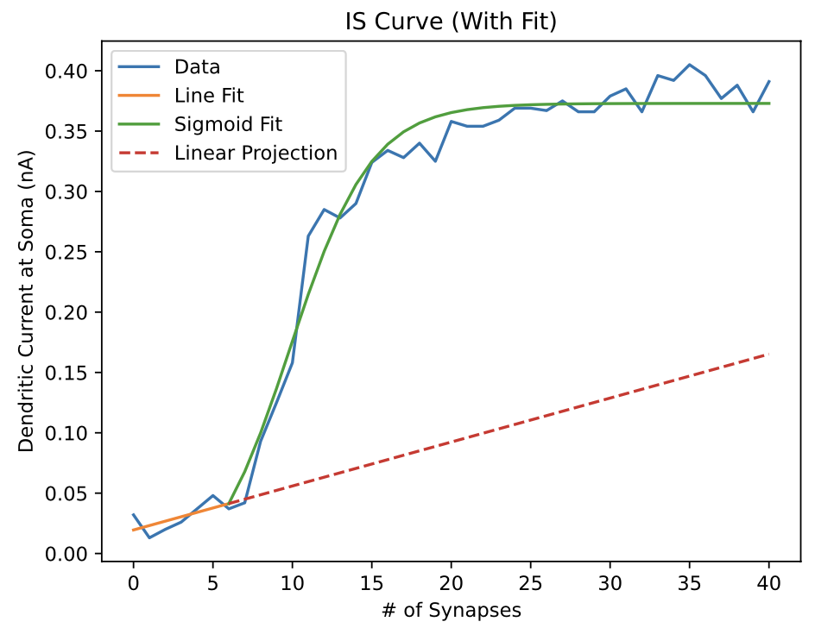
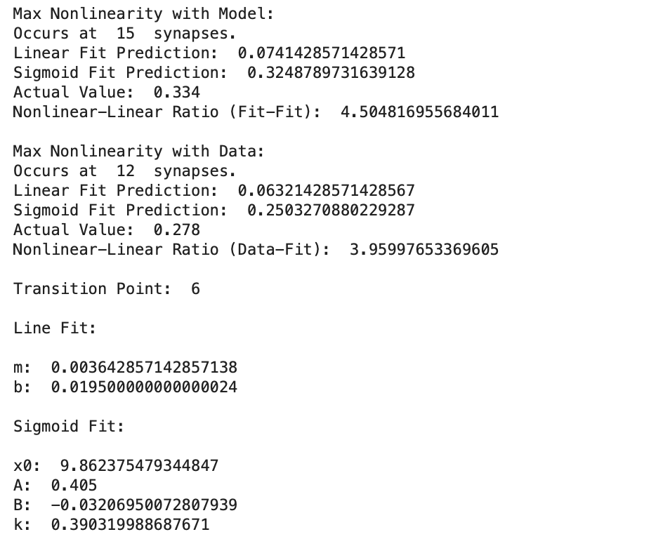
Case 2: SECOND DENDRITE
STIMULUS
Dendrite: h.a2_12122

Slide 9
Case 3: TWO SYNAPSES
STIMULUS
Dendrite: h.a1_111, h.a2_12122

Slide 10
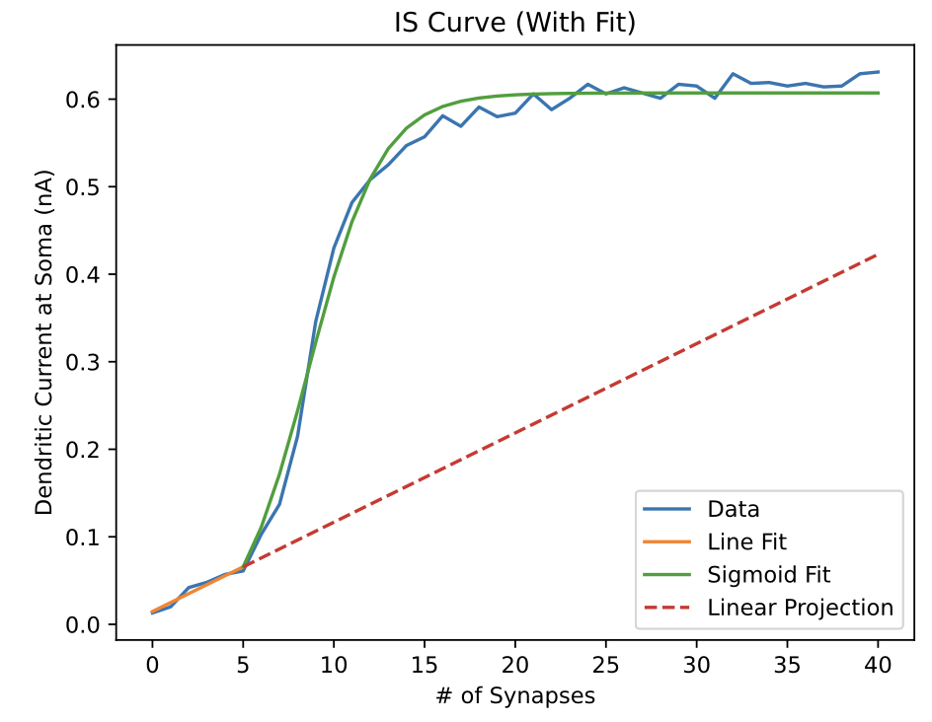
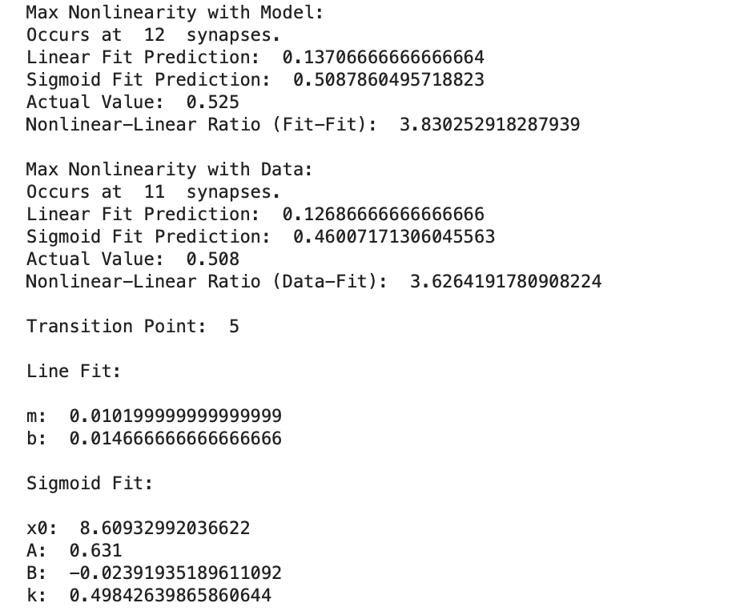
Case 3: TWO SYNAPSES
STIMULUS
Dendrite: h.a1_111, h.a2_12122

Slide 11
Compiled Cases

Slide 12
Compiled Cases

